Slide 1
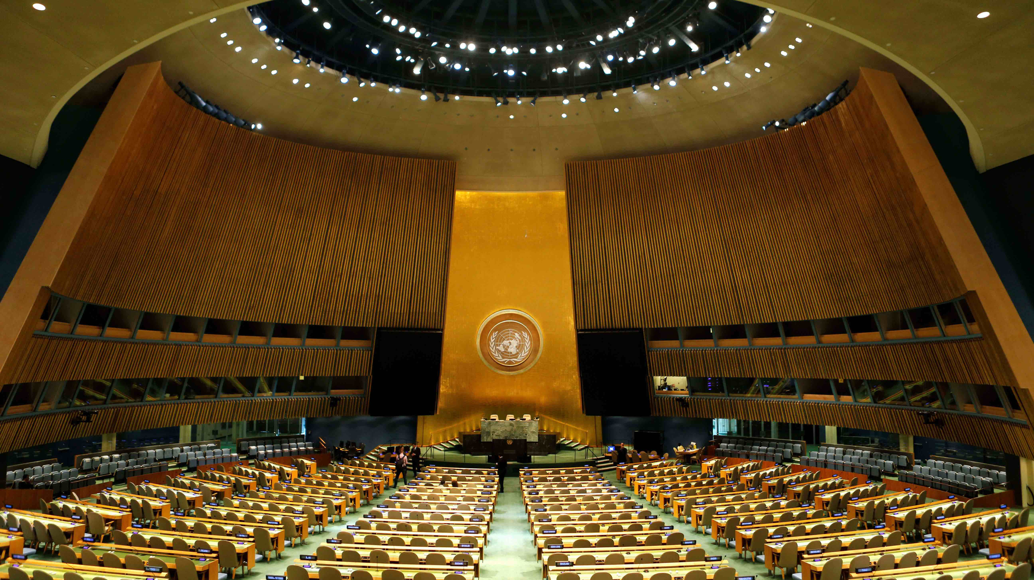
Introduction to Model UN
IAA 2023-24
Week 5

Slide 2
Agenda
Key Attributes of a Crisis Committee
Structure of Crisis Committees+
Crisis Arcs and Crisis Notes
Country Selection for Next Week
Conference Attendees Stay After

Slide 3
An Introduction to Crisis Committees
…or the kind committee where you can kill your enemies and war crimes are sanctioned

Slide 4
Key Attributes of a Crisis Committee
Crisis Committees:
A crisis committee is a decision-making body that has more power than a traditional committee.
Whilst General Assemblies recommend and build consensus, focusing on creating and refining frameworks for the nations party to align their actions, crisis committees produce action.
This means that the body has power unto itself that does not need to be granted by the obedience of its members.
Groups that look like this include a cabinet, a royal court, a board of directors of a company, a rebel group, or really any small group which possesses political power.
Crisis is also more dynamic and fast-paced than traditional committees, so each delegate is incredibly influential.

Slide 5
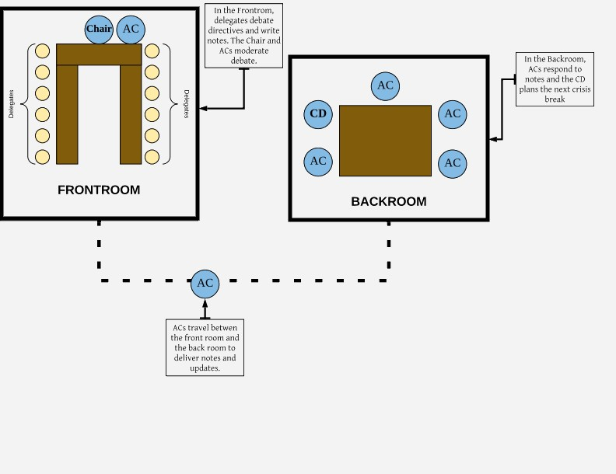
The Structure of a Crisis Committee
Crisis Committees:
Crisis committees all have a “Frontroom” and a “Backroom.”
The Frontroom is the committee room itself. Instead of writing resolutions, the Frontroom will pass short documents called directives, which enact the will of the committee.
Directives use the resources that the committee controls and can create military actions, policy proposals, press releases, and more.
Backroom also deals with crisis notes.

Slide 6
Crisis Notes: Part I
The Backroom Stuff
In the backroom you can take actions without the need to build consensus in the front room and build up your own personal resources.
You can do this because of crisis notes. Crisis notes are notes written in character to fictional confidants.
Backroom staffers will respond to these notes in character
The logistics of notes are simple, if your committee has crisis elements, you receive one or two notepads at the start of your first session.
You use these to write plans, actions, questions, plots, etc.
The dais of your committee will then periodically collect these notepads and respond to your note.

Slide 7
Crisis Notes: Part II
What to Write: Three R’s: Resources, Request, Reasoning
Resources: Over the course of a crisis committee, you will likely acquire several important resources.
This statement helps distinguish your note from the rest of delegates. All you need to do is state a reminder of what you already have.
While this does not need to cover everything, it should be relevant to the next part of the note.
Request: The next step is to go through what you want to do next.
Keep requests small for the most part, these are more likely to be granted.
Ask for anything which is an extension of your current resources. You can move your resources, transform them into something new, upgrade them, there’s no shortage of ways to use a resource.
If your request is simple and clear, it will likely be accepted.
Reasoning: This final part is the most important in your note.
It provides a justification for your request and gives the dais more insight into your ultimate strategy.
When the dais has this information into your motivations, they can respond to your notes more comprehensively.
Give a short explanation as to why this request aligns with your agenda or plans.

Slide 8
Crisis Arcs
You will be writing dozens of notes over a weekend and together these notes form what is called your “arc”.
It is important to have some idea of what you want the end goal of your arc to be, that way you can be more direct about getting there.
There are generally three phases to a crisis arc, building resources, building logistics, and executing your plan.
Each note you will build upon what you have accomplished in previous notes until you reach the point where you can accomplish your goal.
Your “arc” is something you can start planning ahead of time: start early when you get your background guide!

Slide 9
Special Types of Crisis: JCC
JCC
JCCs are made up of at least two, separate committee rooms.
Regardless of the size of a JCC, the rest of the structure remains the same.
The committee rooms in a JCC are separate in their physical location, but united under the same committee topic.
Common topics are wars or competing political factions: one committee room can be on one side of the conflict while the other committee room is on the other side.
A popular committee for this type is the American Revolution. One room would be the British and the other would be the American Revolutionaries.

Slide 10
Next Week: Pick Your UNSC Member
Non-Permanent Members
Non-Permanent Members Cont.
Veto Powers
United States of America
People’s Republic of China
United Kingdom of Great Britain and Northern Ireland
French Republic
Russian Federation
Federal Republic of Germany
Portuguese Republic
Commonwealth of Australia
Gabonese Republic
Federal Republic of Nigeria
Republic of South Africa
Kingdom of Morocco
Republic of Lebanon
Republic of India
Islamic Republic of Pakistan
Federative Republic of Brazil
Republic of Guatemala
Republic of Colombia
Argentine Republic
Bosnia and Herzegovina
Republic of Azerbaijan
Republic of Lithuania

Slide 11
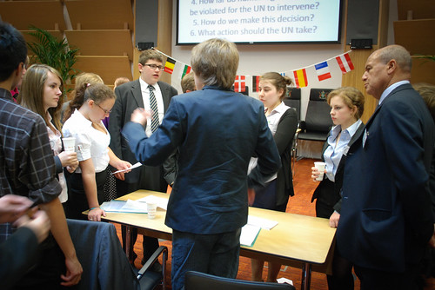
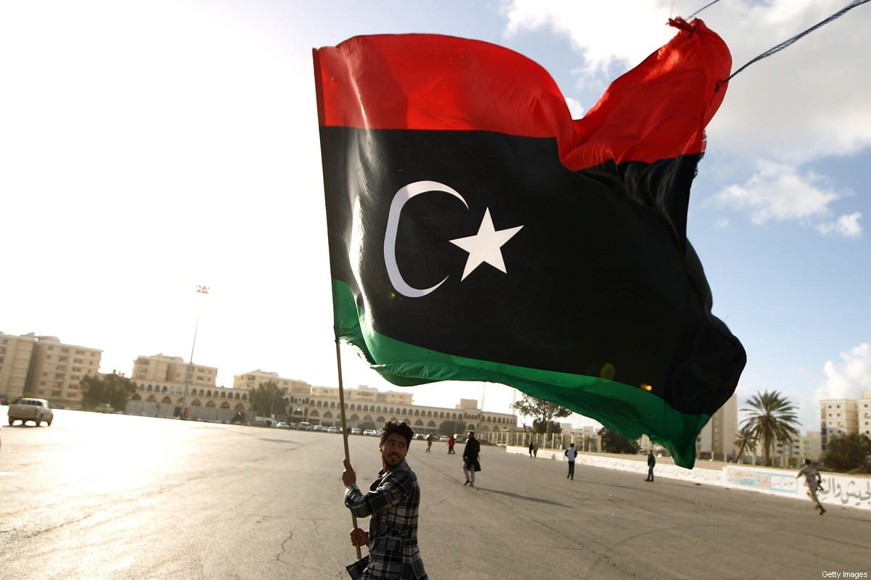
Questions?
Handouts for next week’s simulation: Libyan Civil War (2011).
Includes background guide, UNSC Res. 1970 and 1973.
Conference attendees please stay behind.

